Slide 1

CLASSIFICATION OF SIGNIFICANT WATER RESOURCES AND DETERMINATION OF RESOURCE QUALITY OBJECTIVES FOR WATER RESOURCES IN THE USUTU TO MHLATHUZE CATCHMENTS (WP11387)
Project Steering Committee 1, Virtual: 7 June 2022

Slide 2
7. OVERVIEW OF TECHNICAL PROCESS AND PROGRESS SO FAR

Slide 3
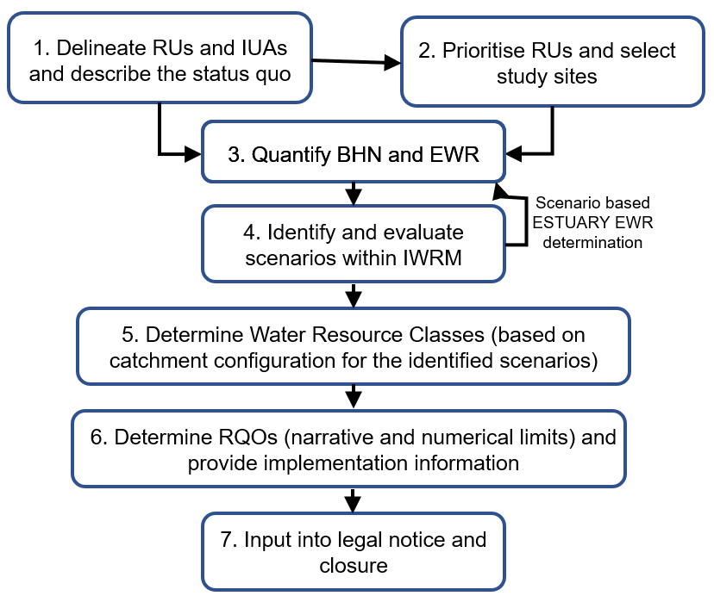
The Study Plan is broken down in tasks and based on the integrated approach for Water Resource Classification, Resource Quality Objectives (RQOs) and the Reserve
7. Prepare legal notice for Gazetting

Slide 4
8. TASK 1 AND TASK 2: STATUS QUO OF THE STUDY AREA
AND
INTEGRATED UNIT OF ANALYSIS (IUA) DELINEATION
AND
RESOURCE UNIT (RU) PRIORITISATION

Slide 5
8.1.1 WATER RESOURCES AND USE (ECONOMY)

Slide 6
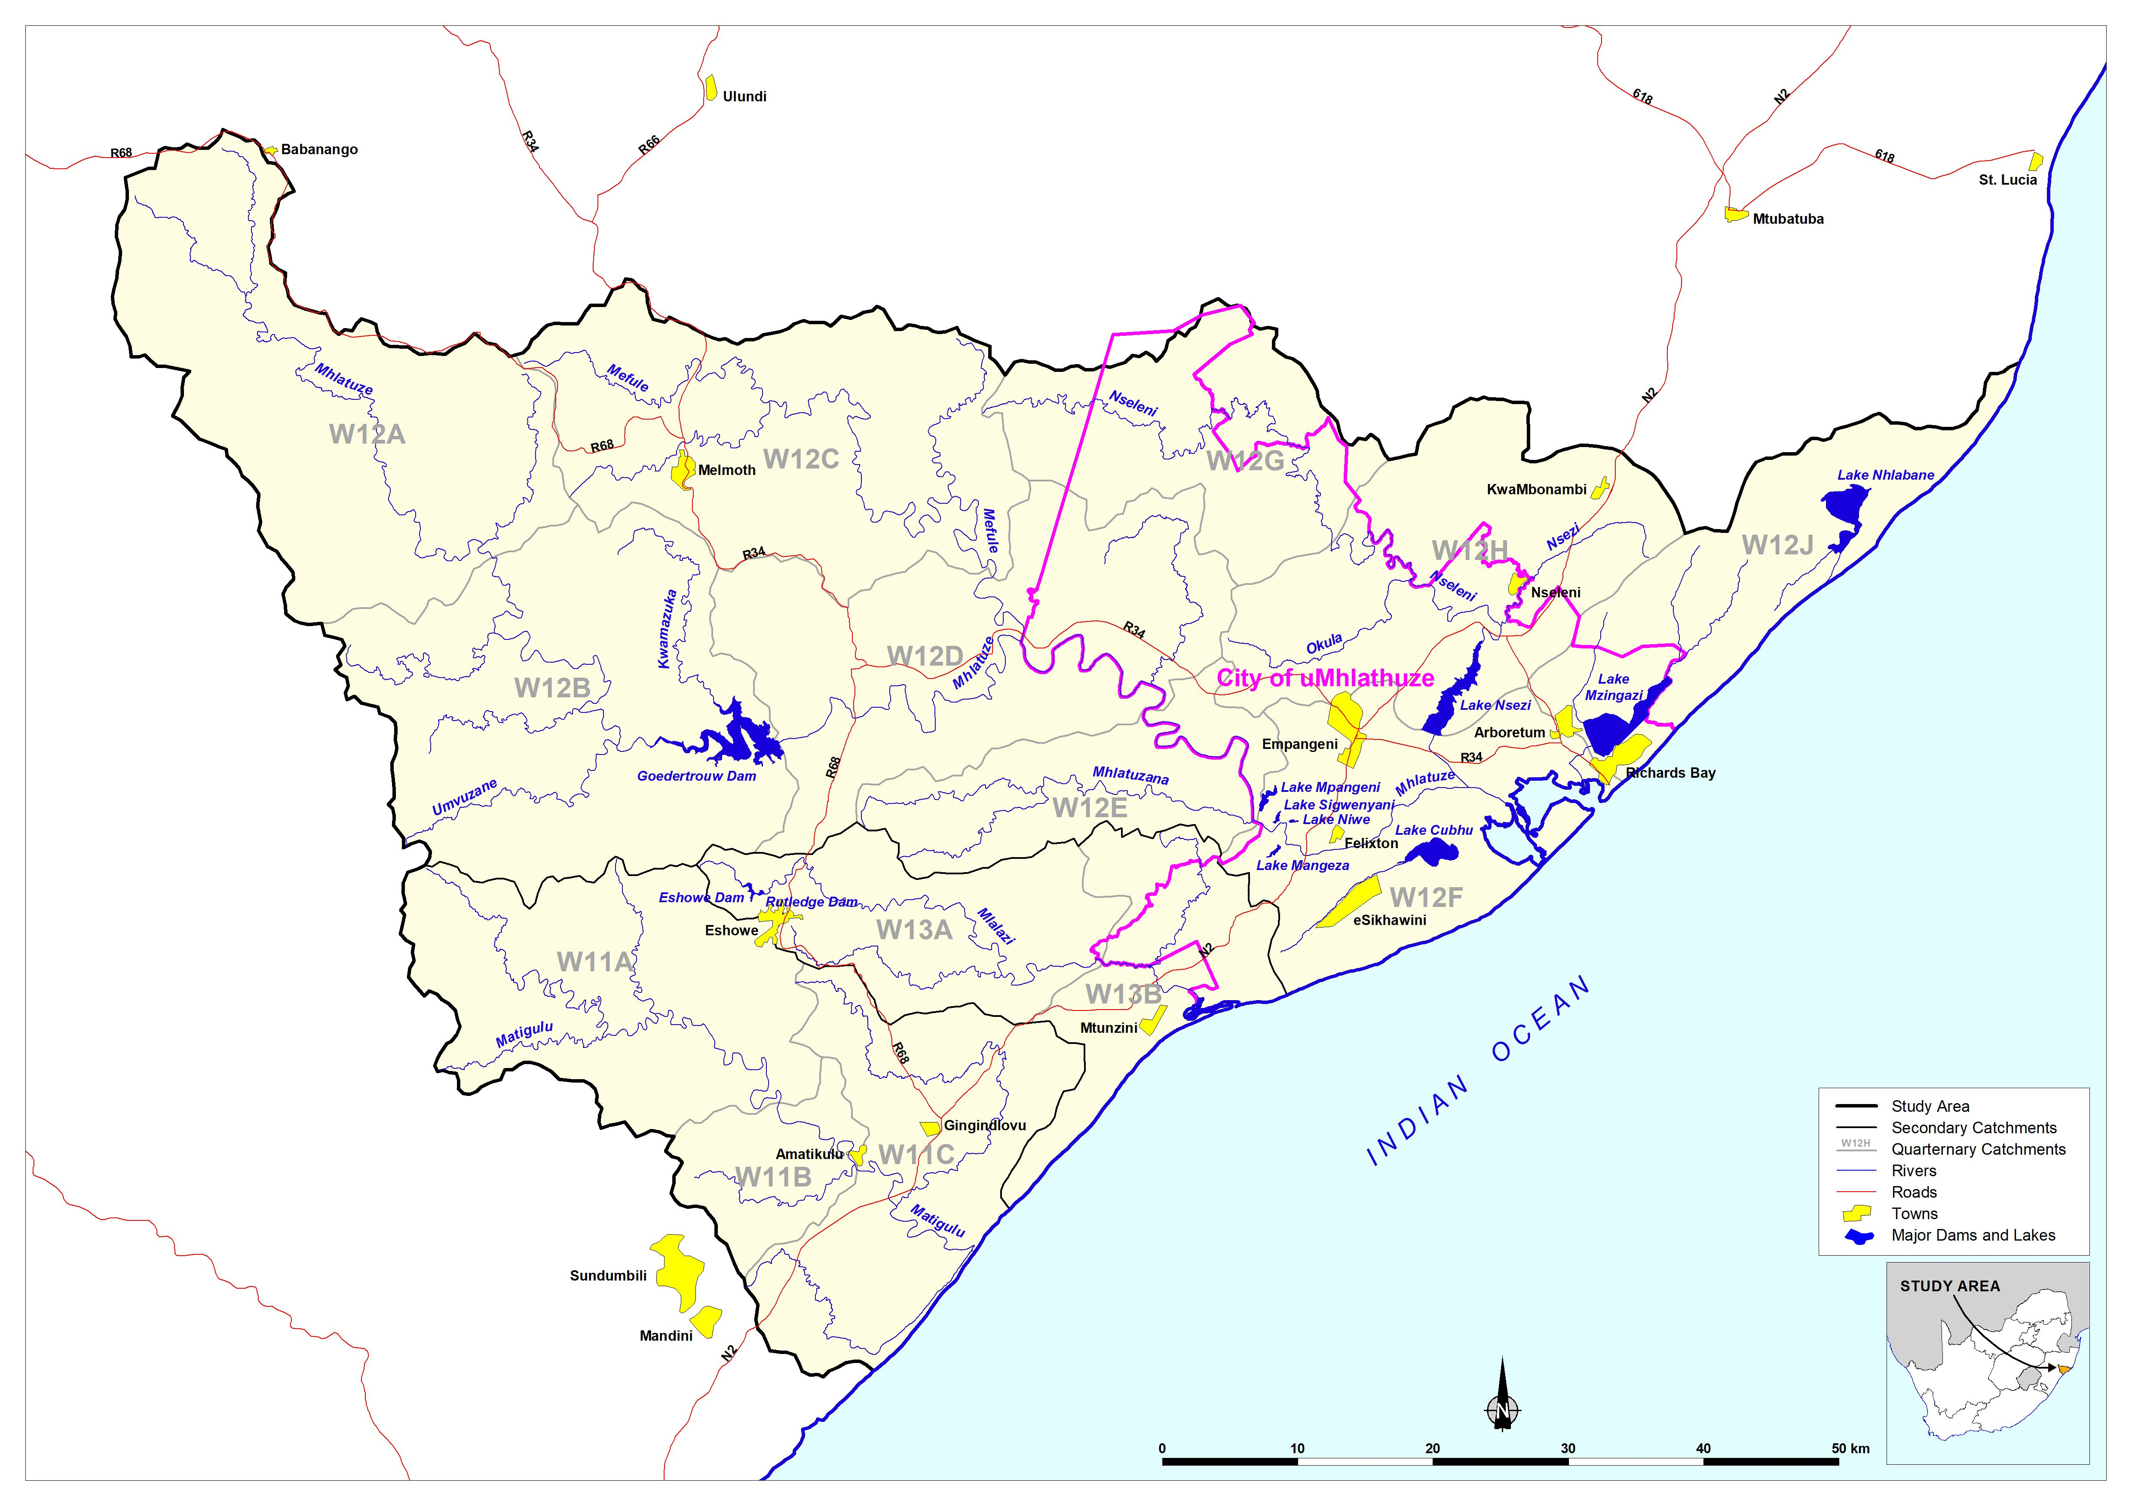
W1
Transfer in from Umfolozi
Transfer in from Thukela

Slide 7
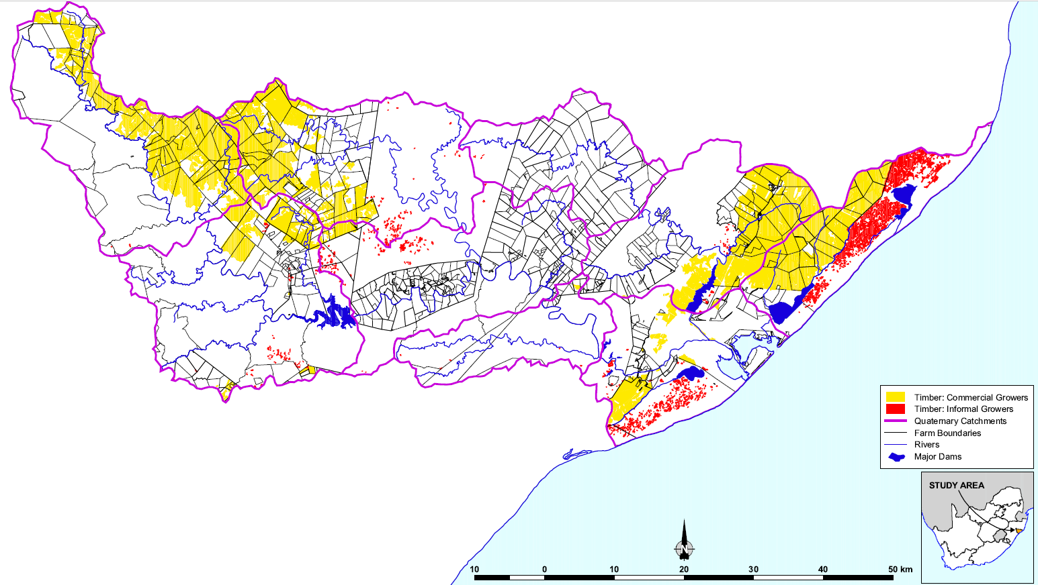
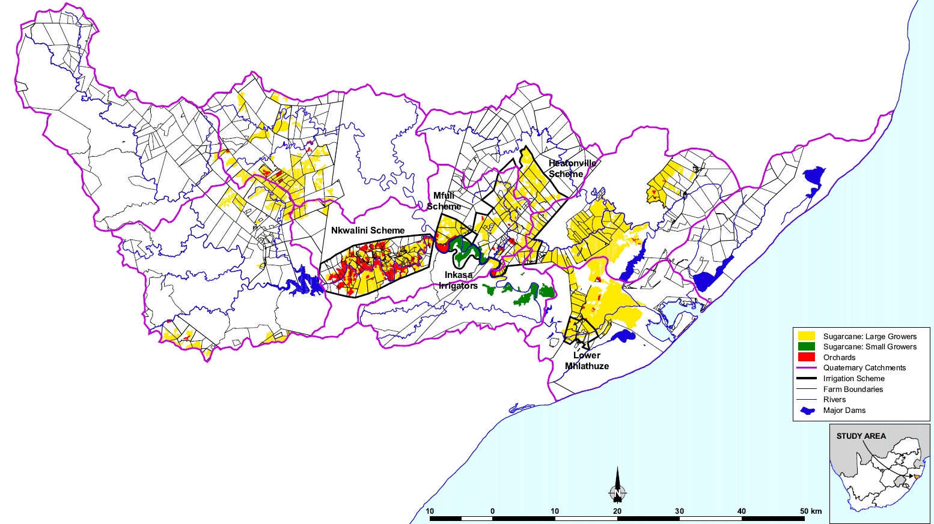
Afforestation
Landuse (source: MWAAS, Reconciliation Strategy)
Irrigation

Slide 8
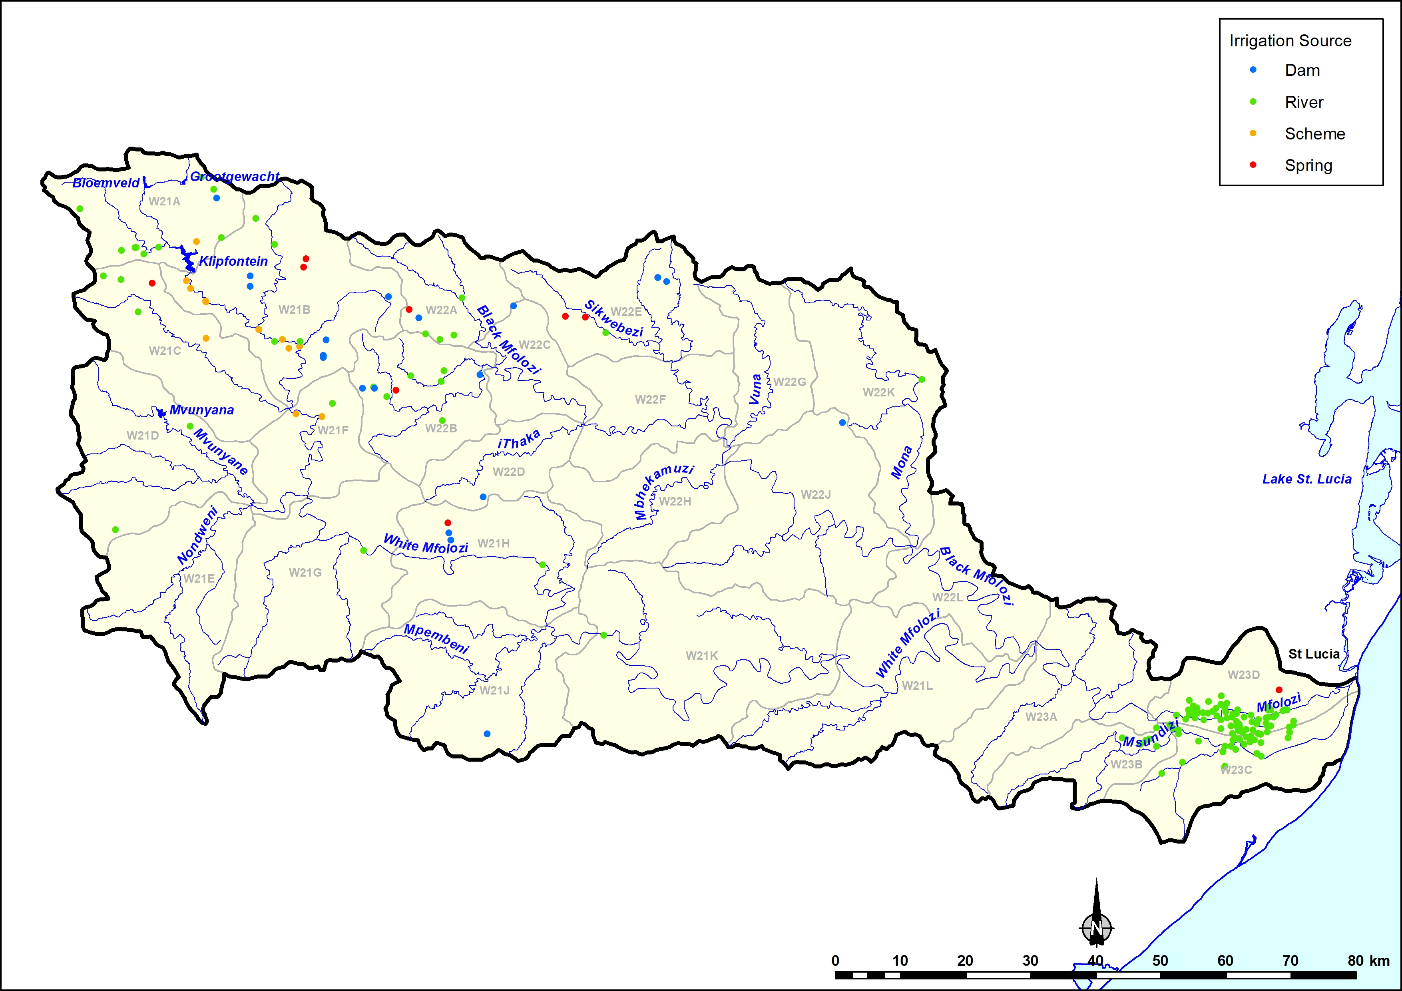
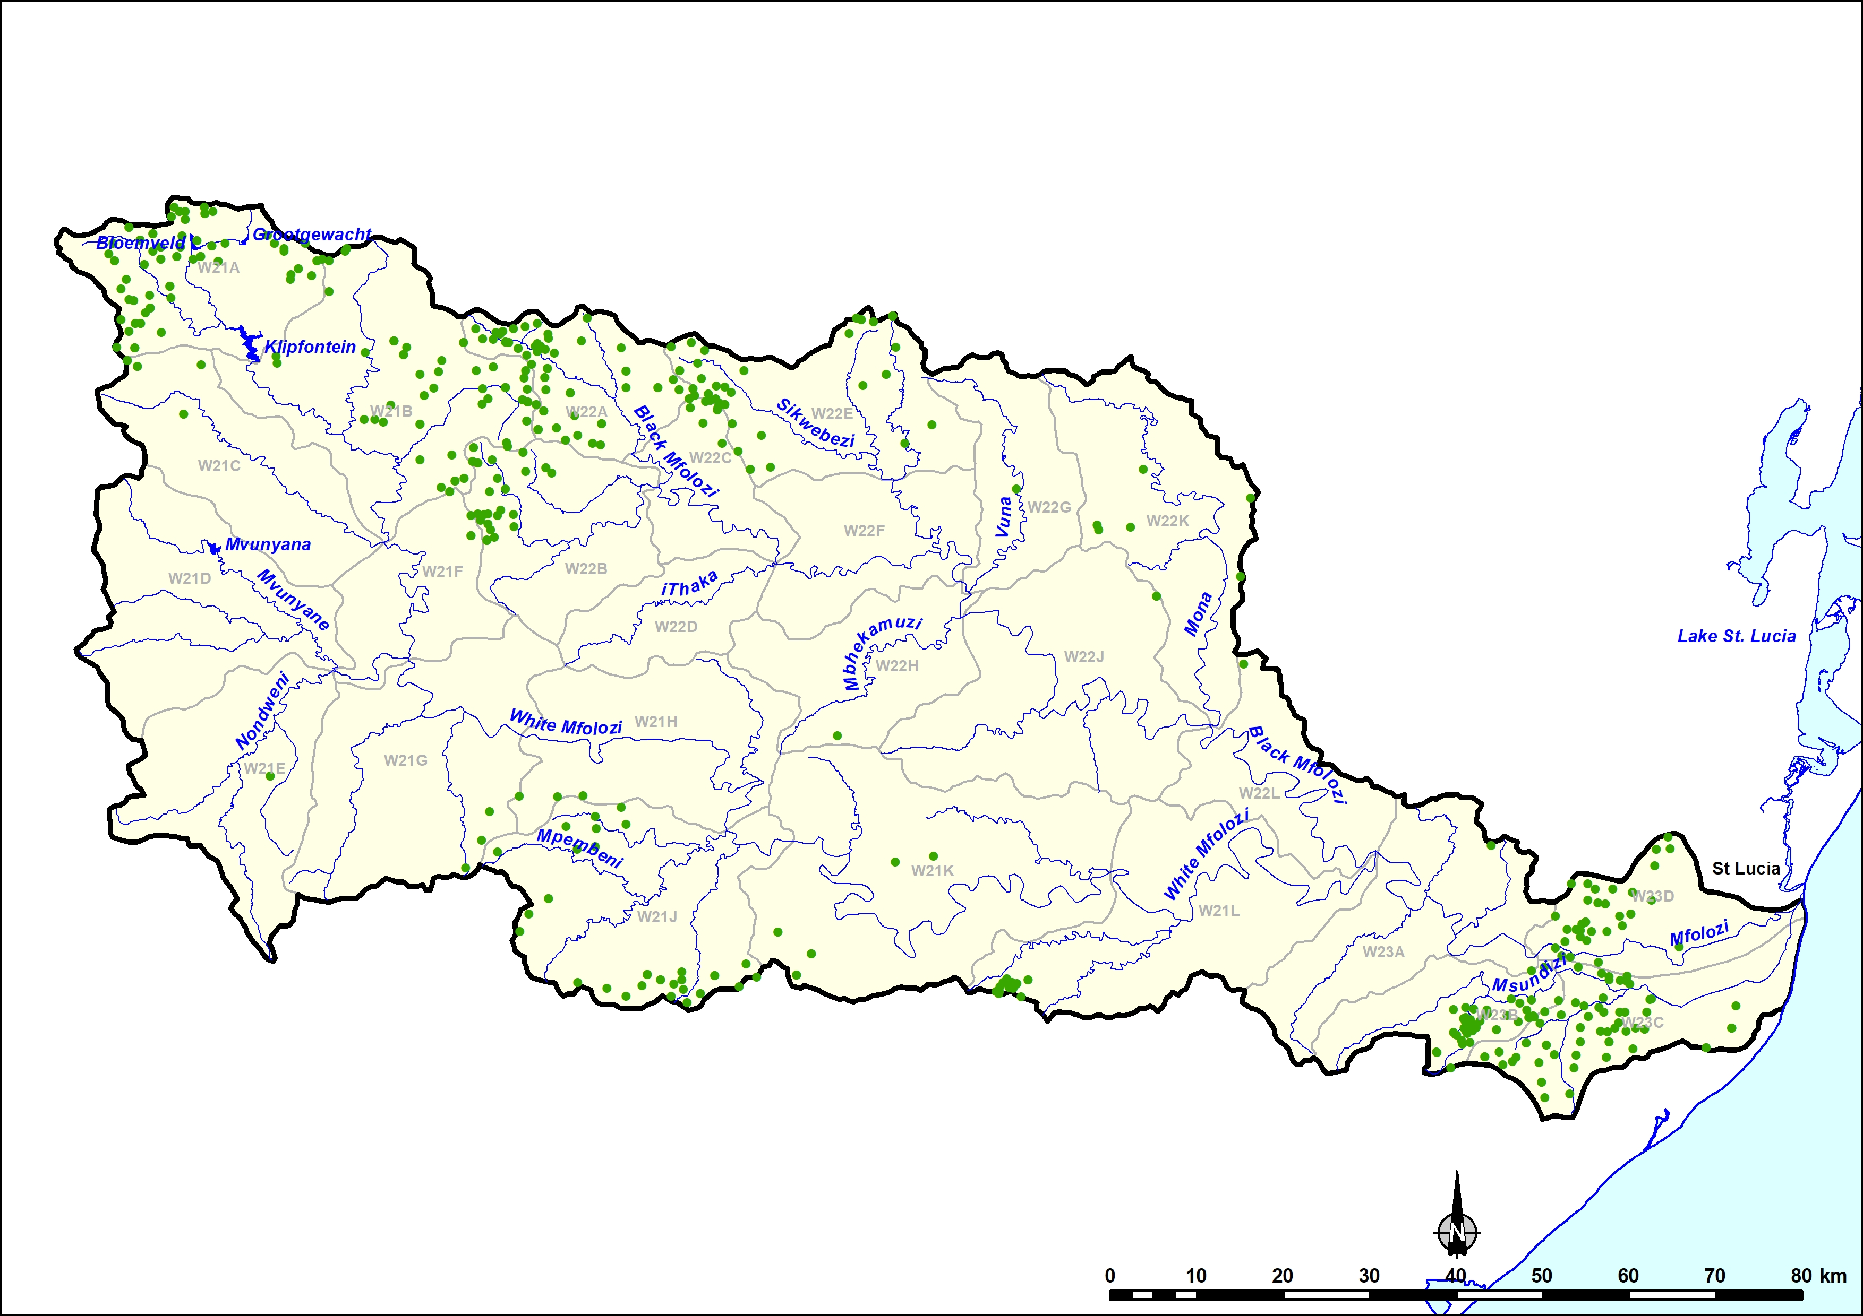
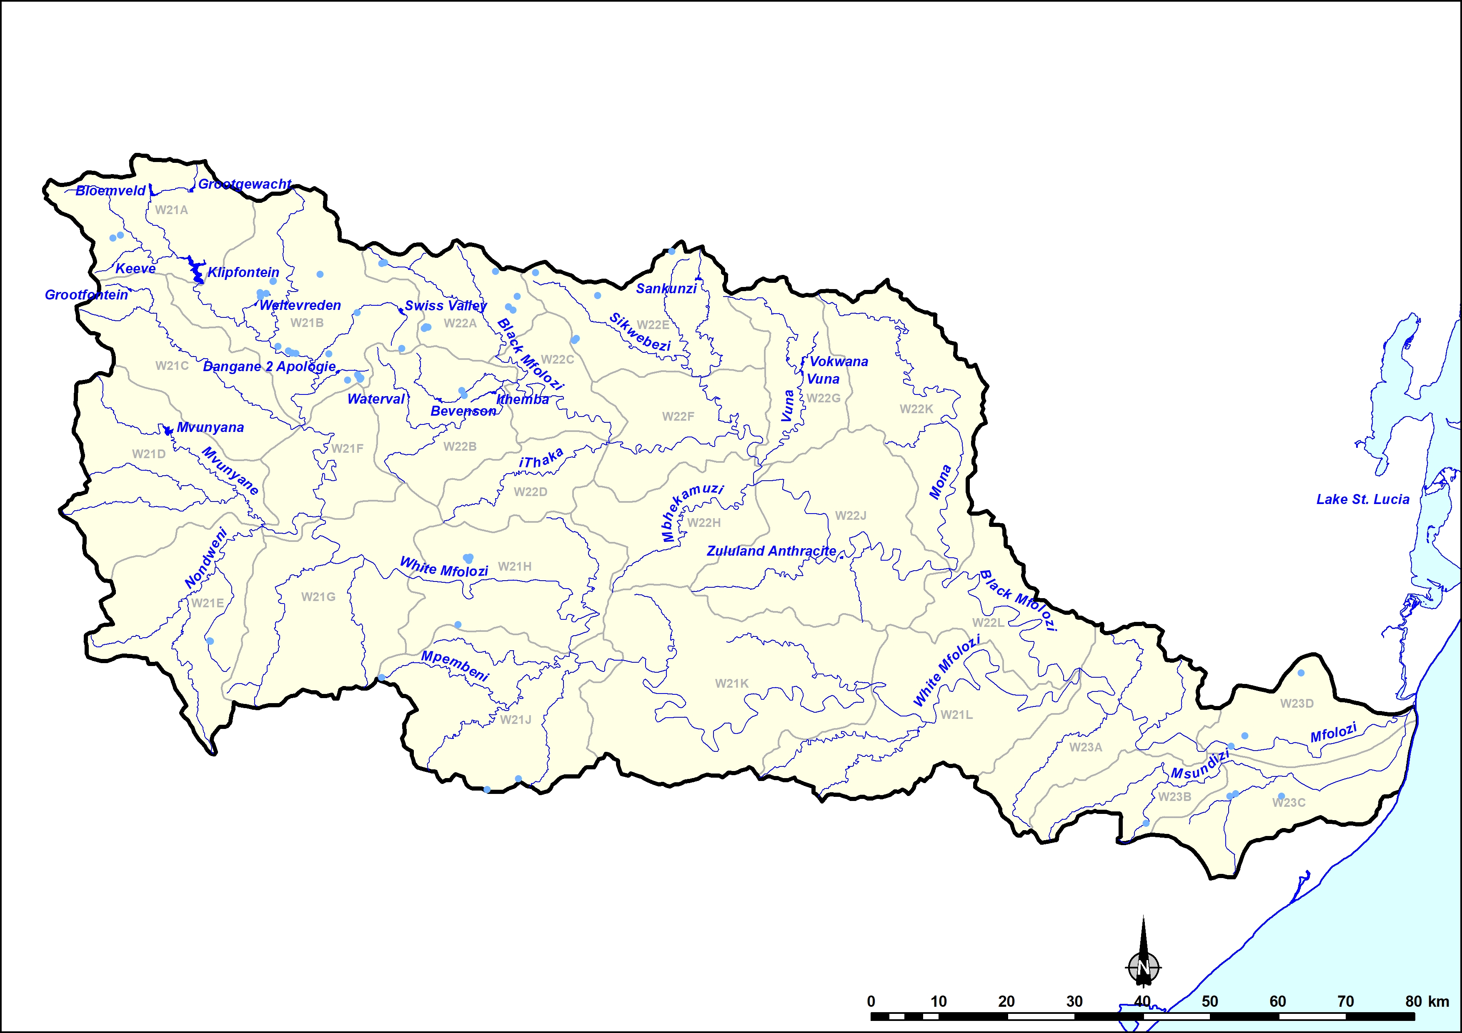
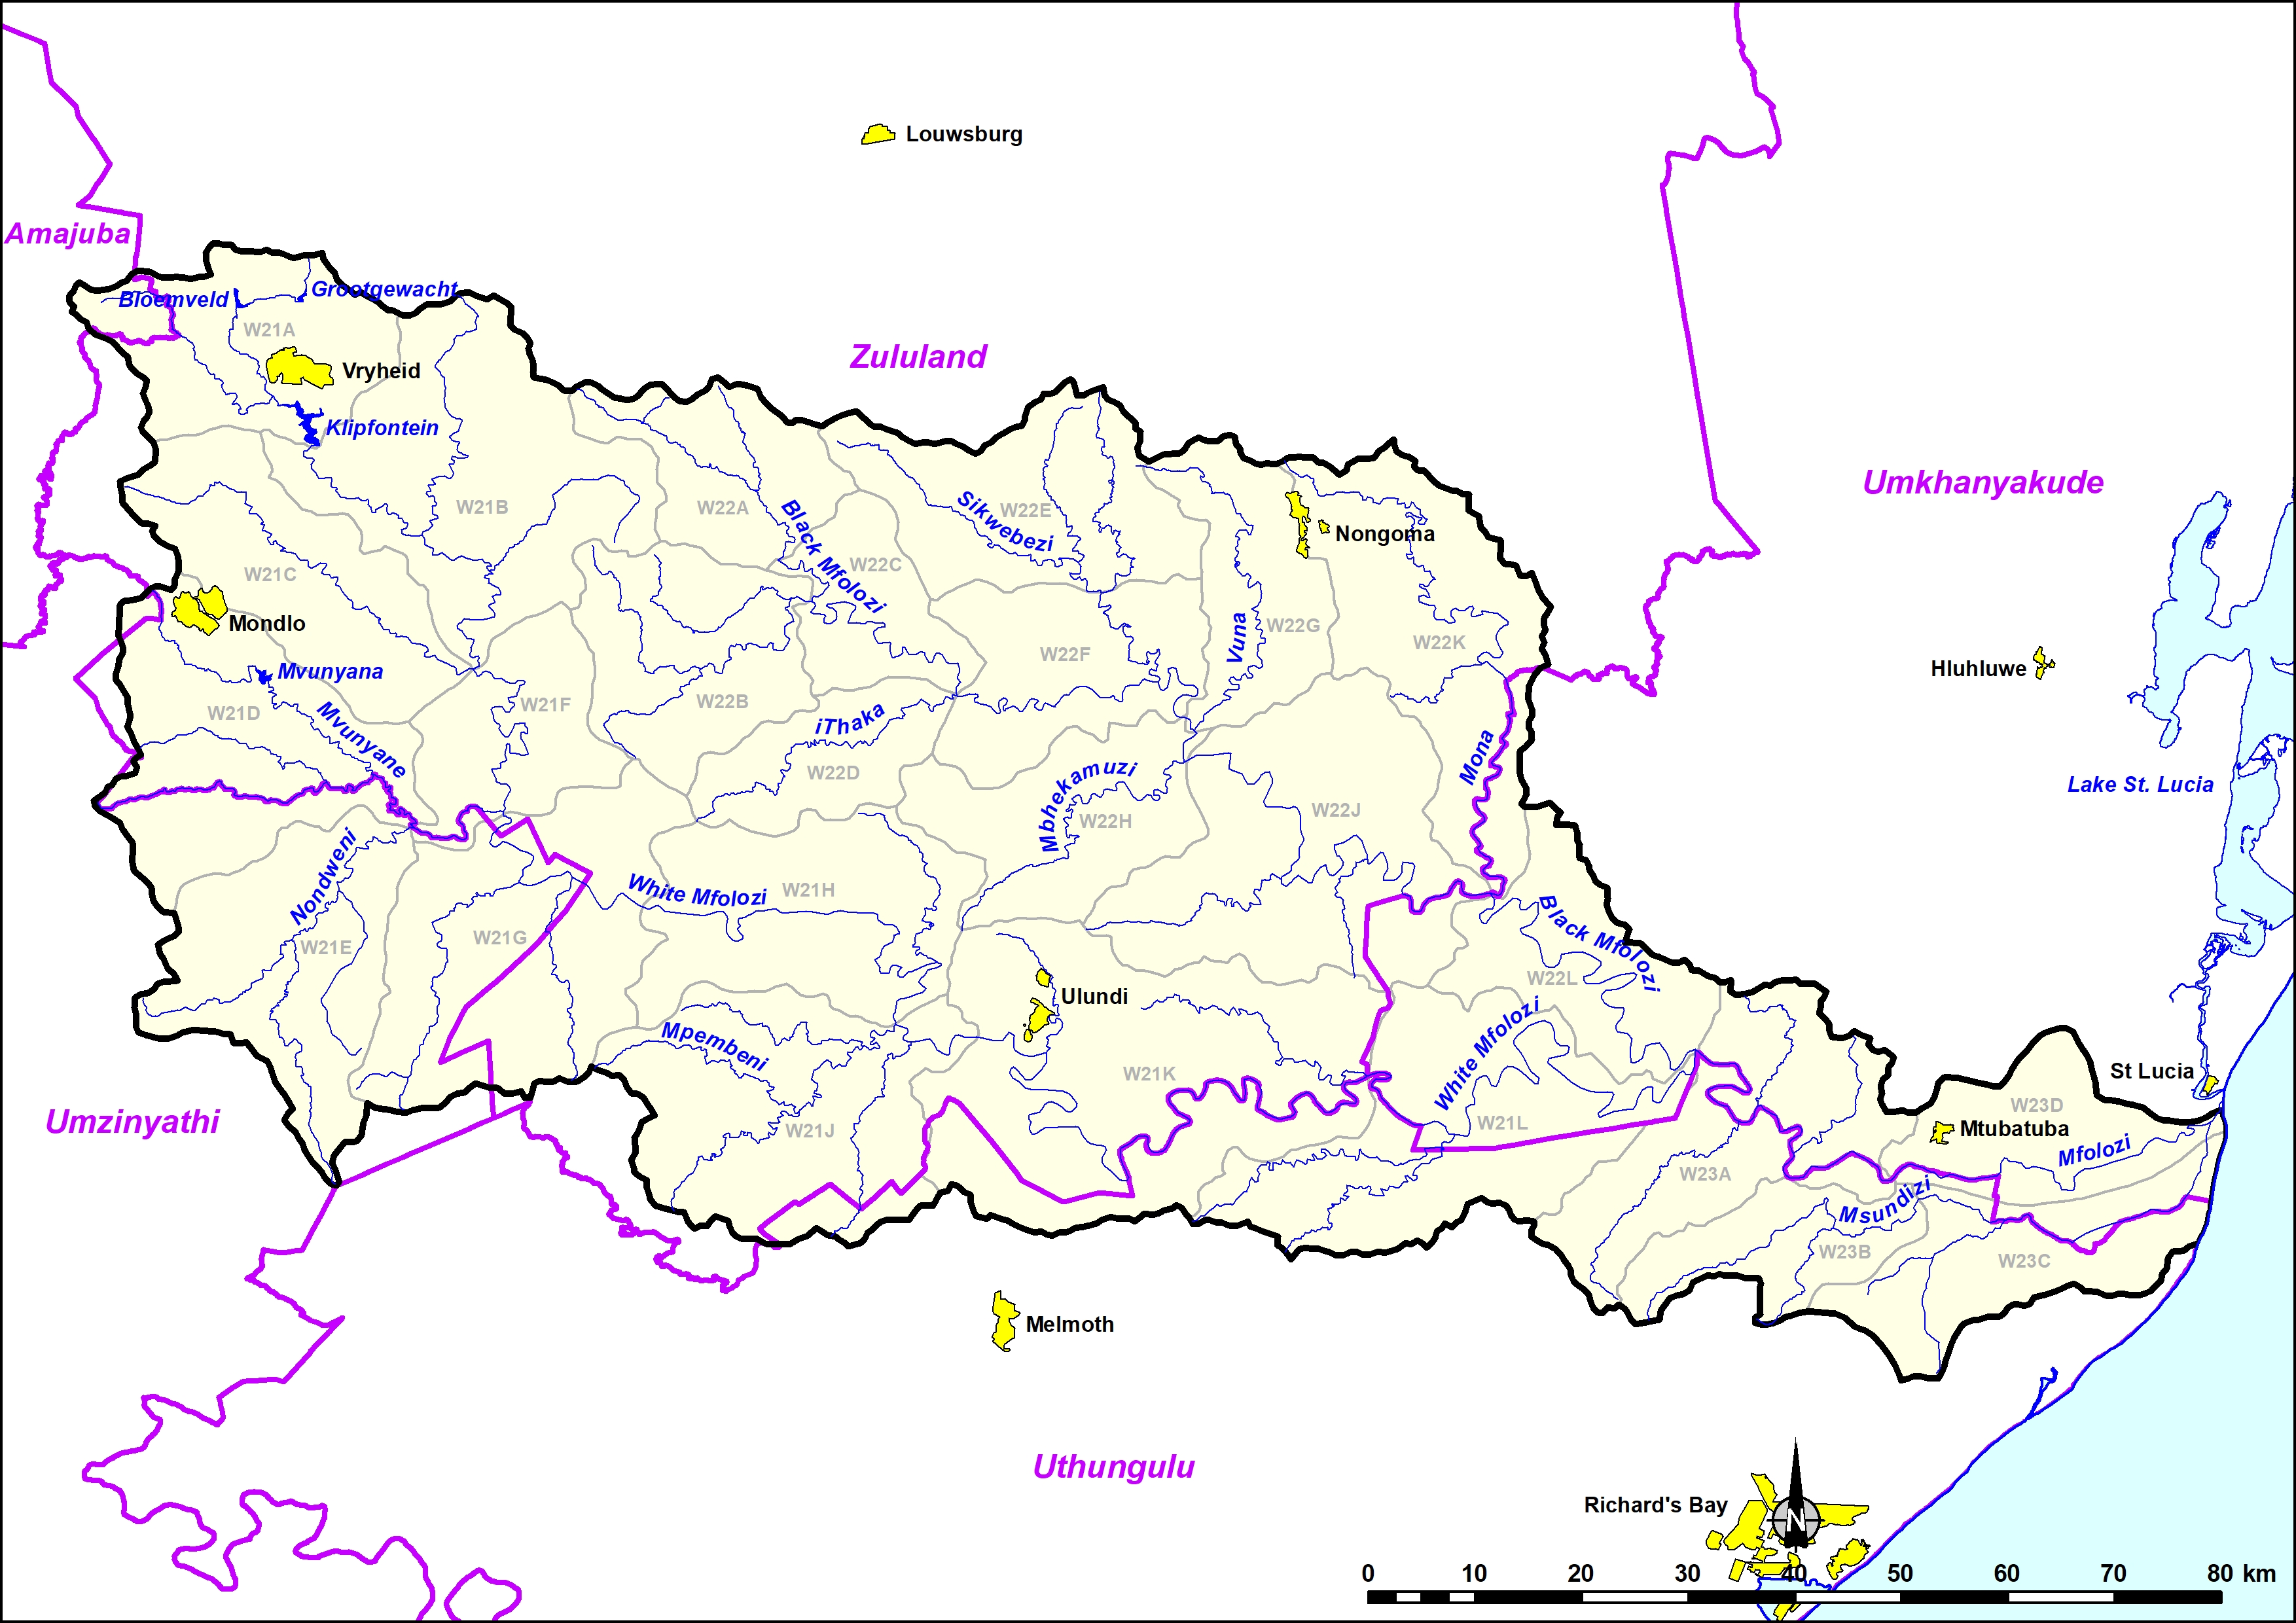
W2
Afforestation
Irrigation
Dams
Domestic

Slide 9
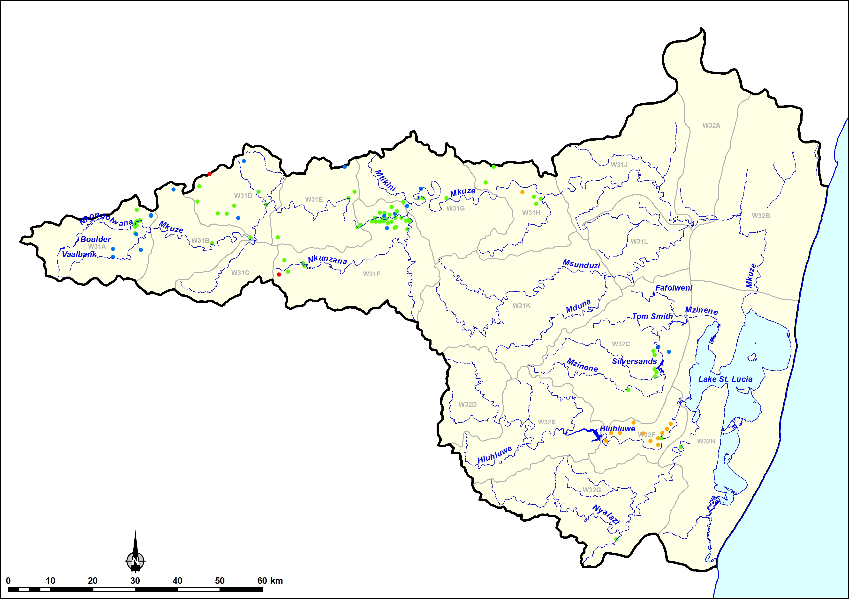
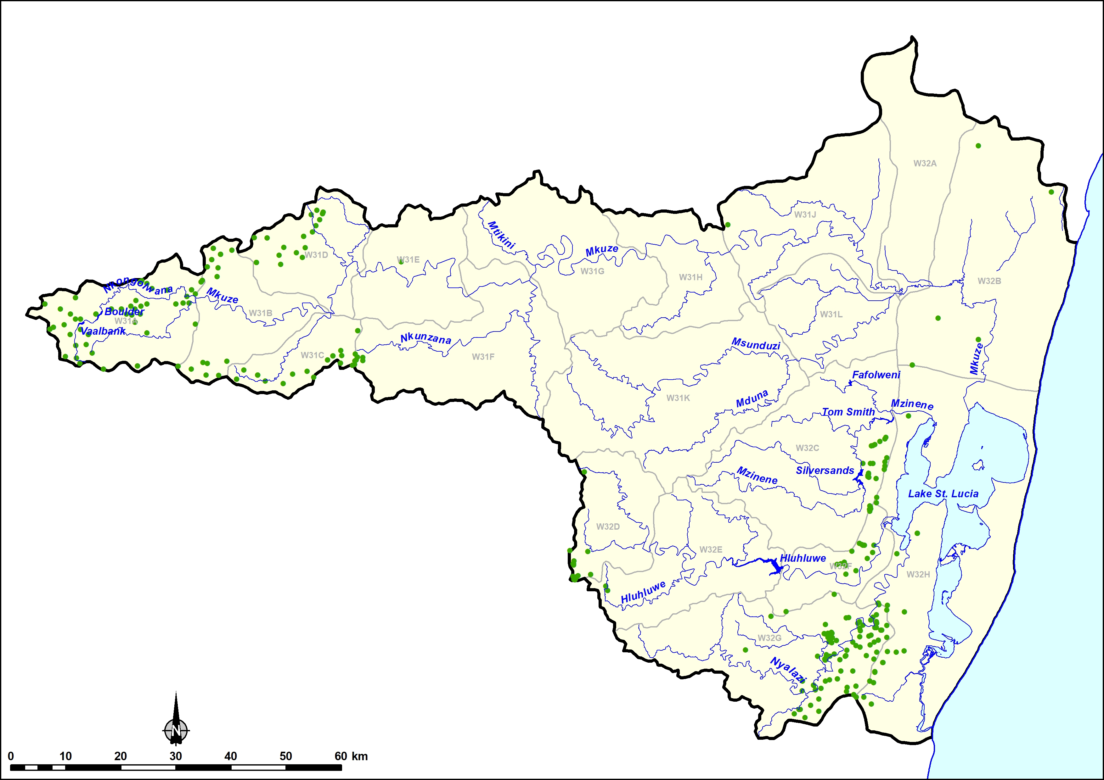
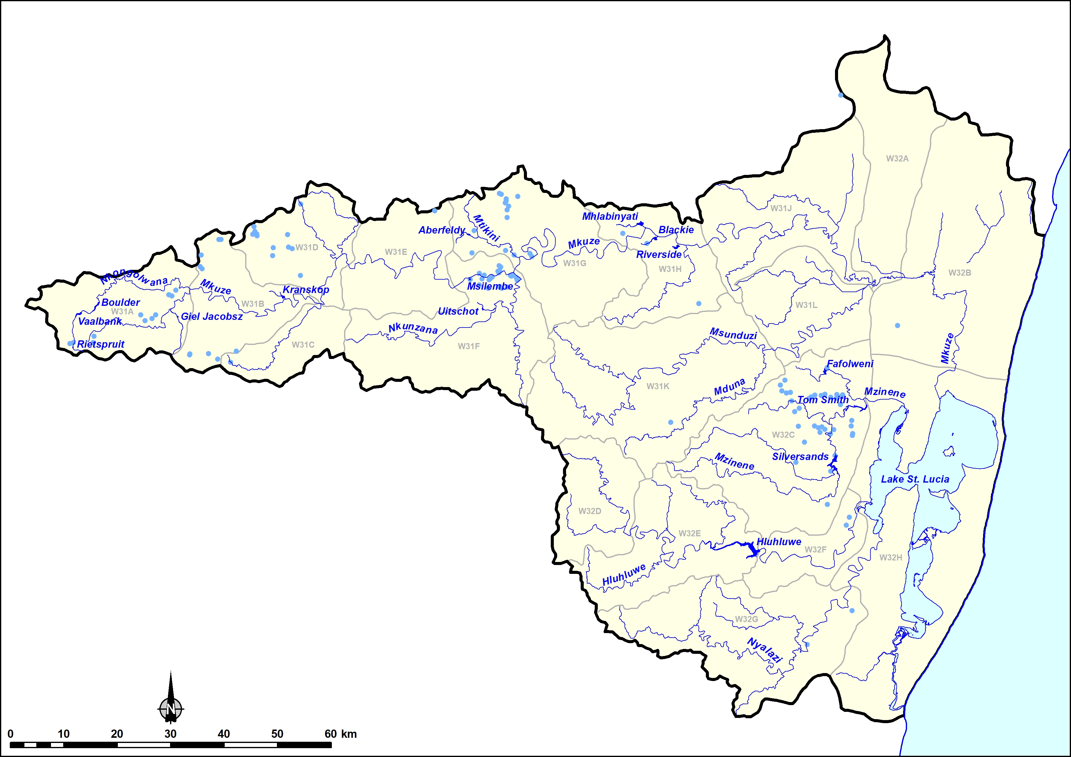
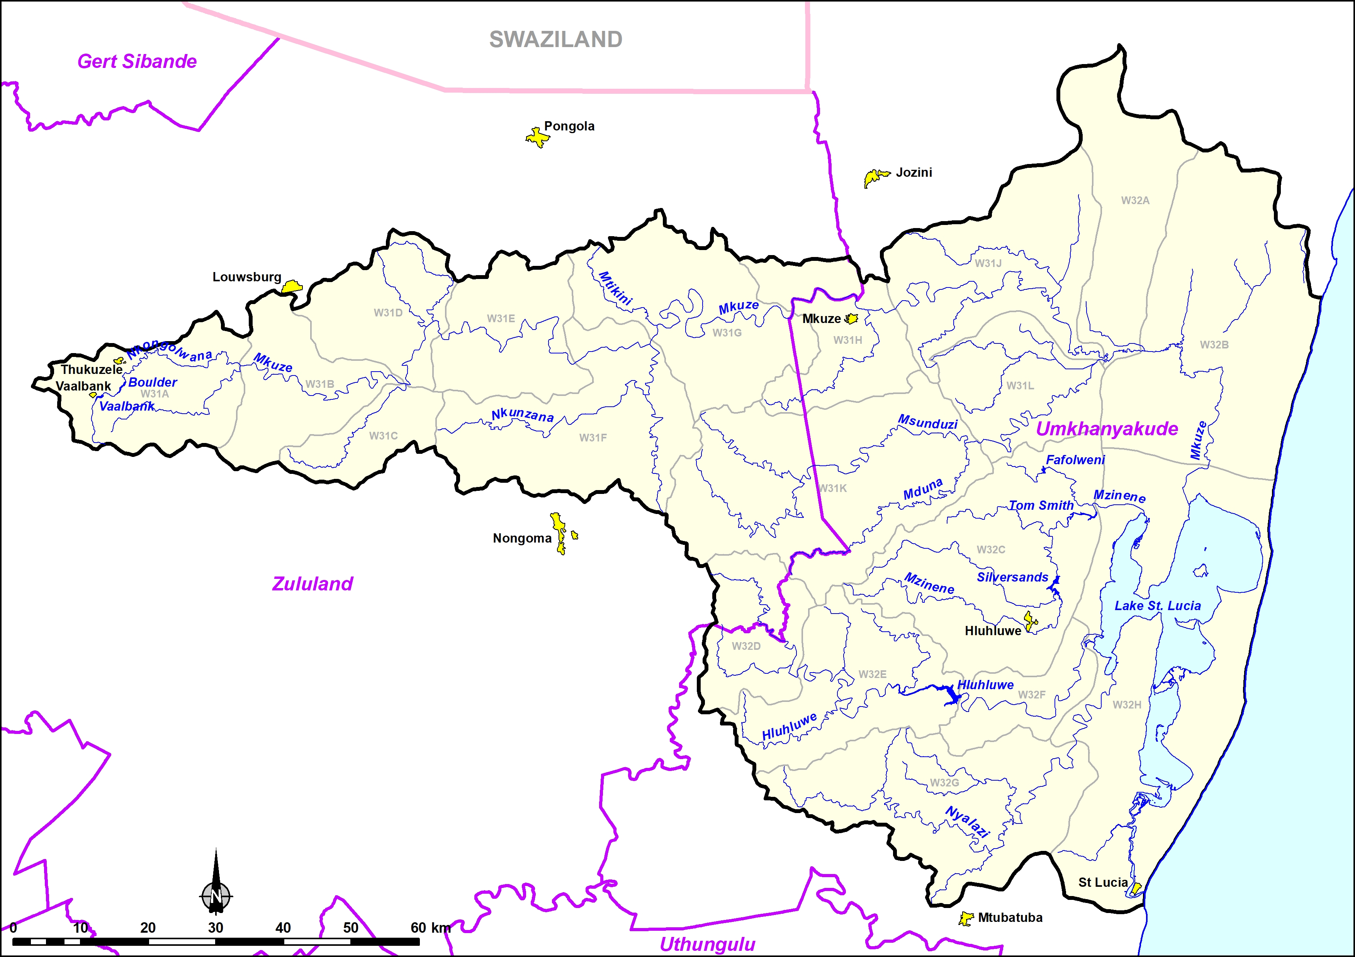
W3
Afforestation
Irrigation
Dams
Domestic

Slide 10
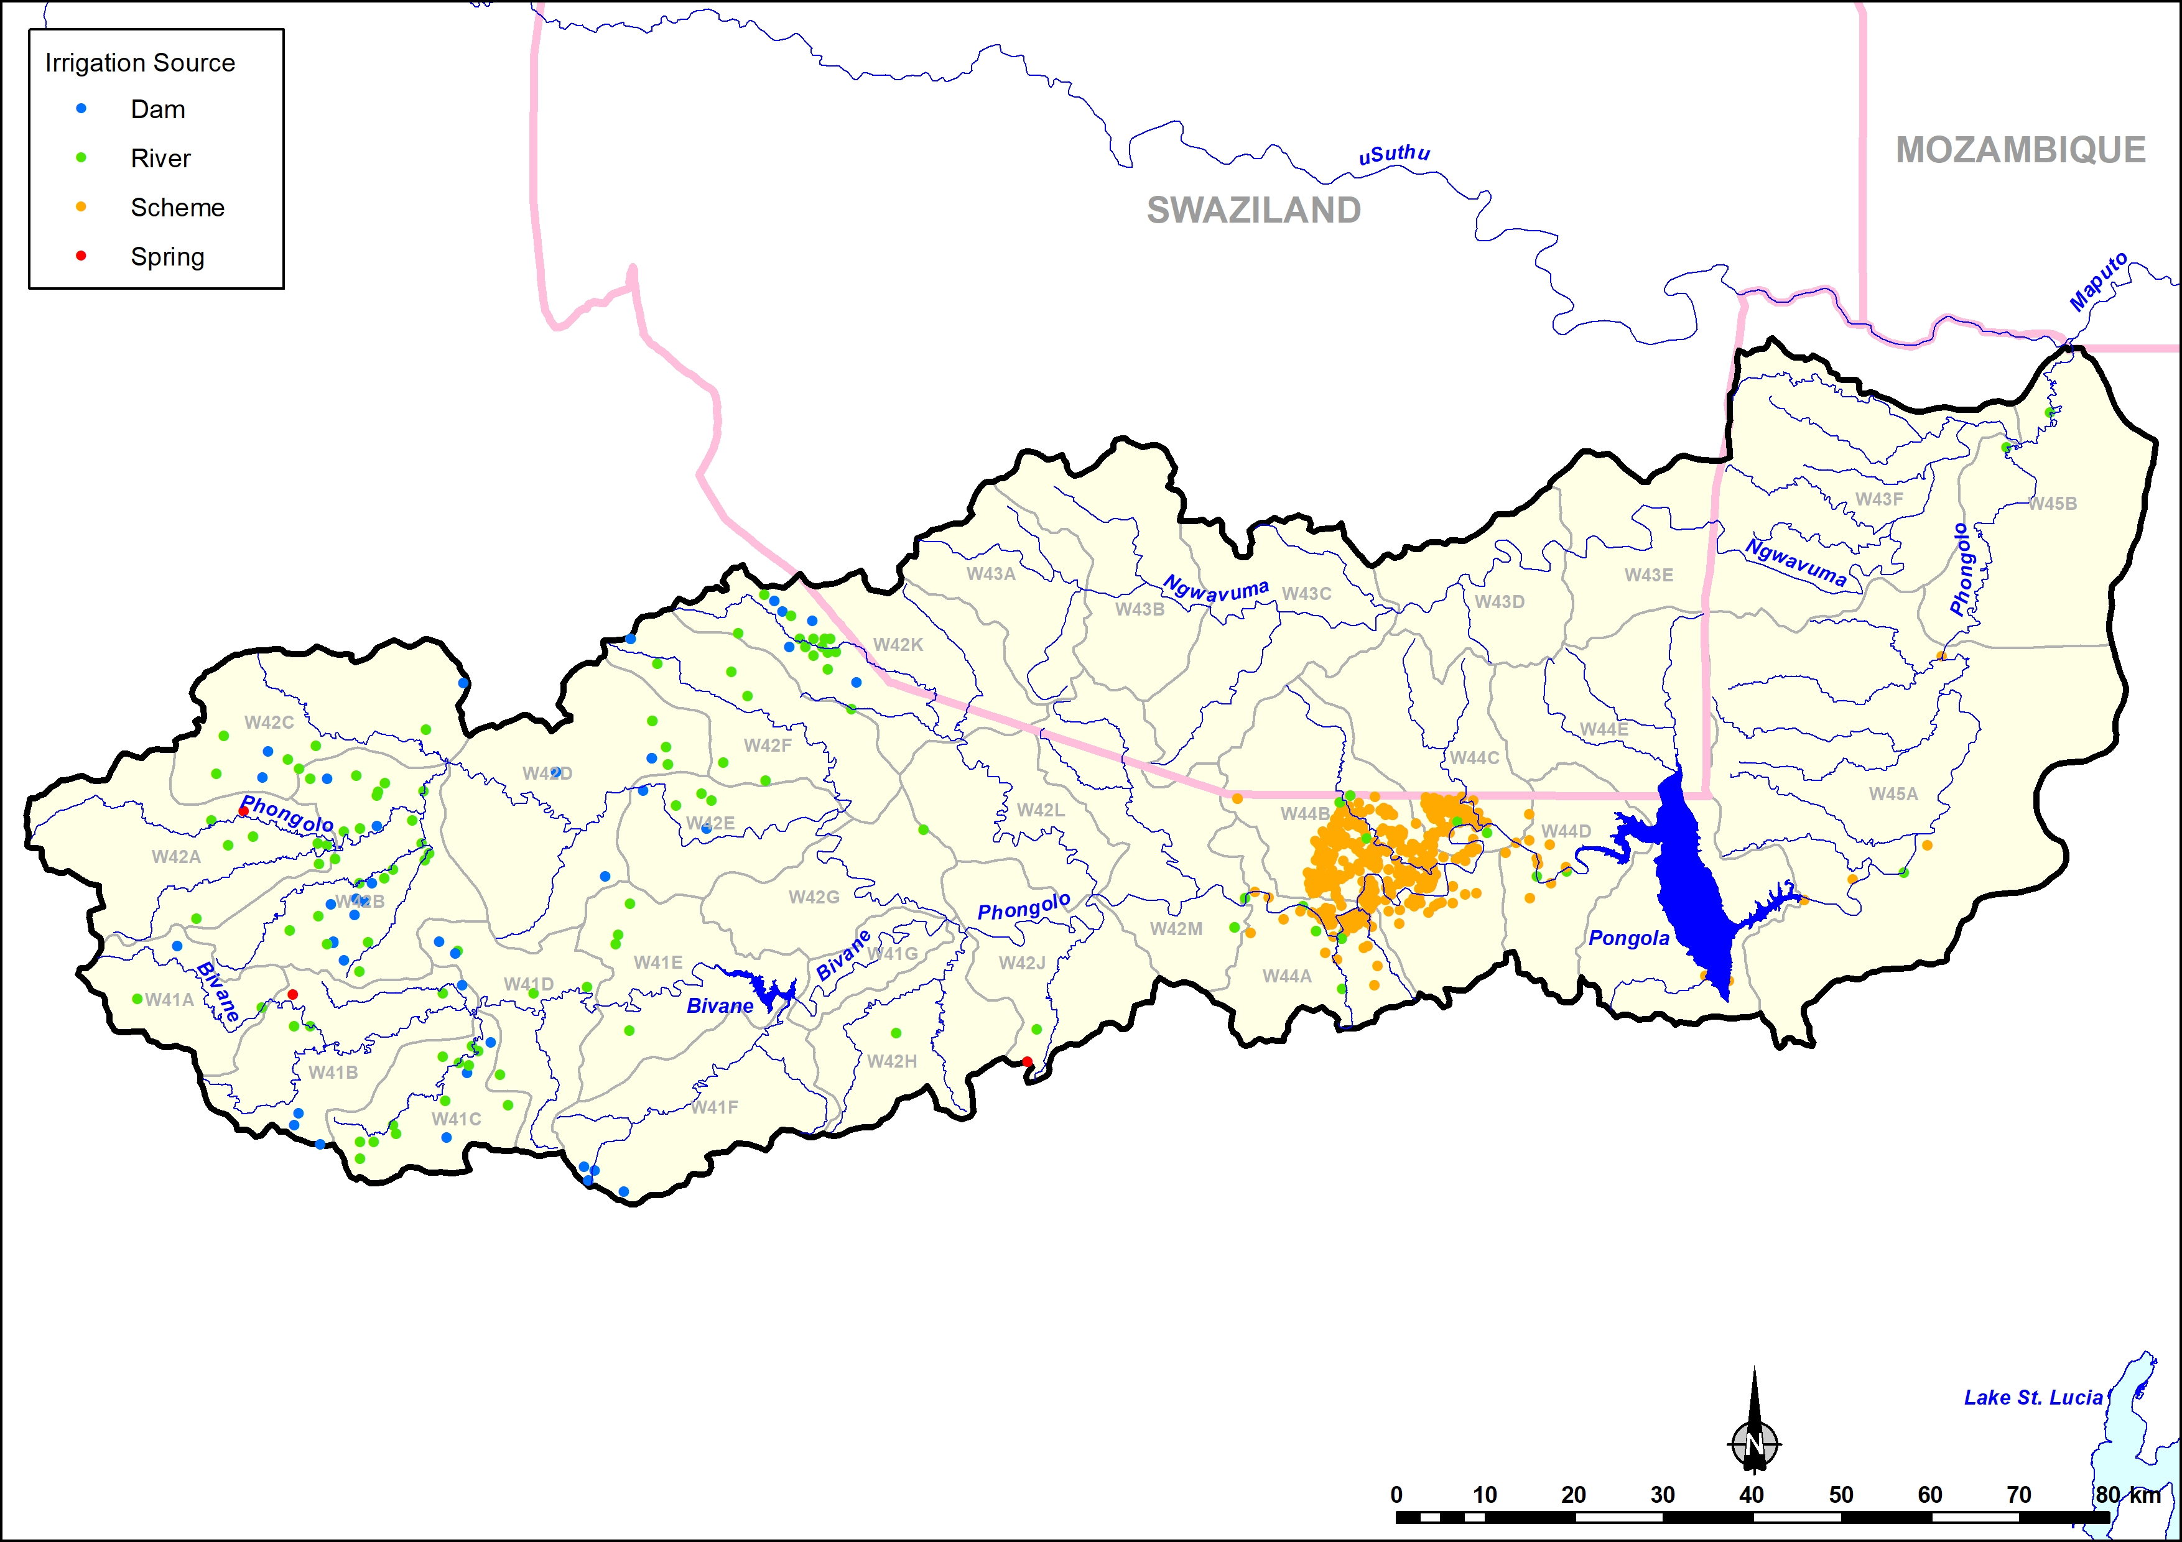
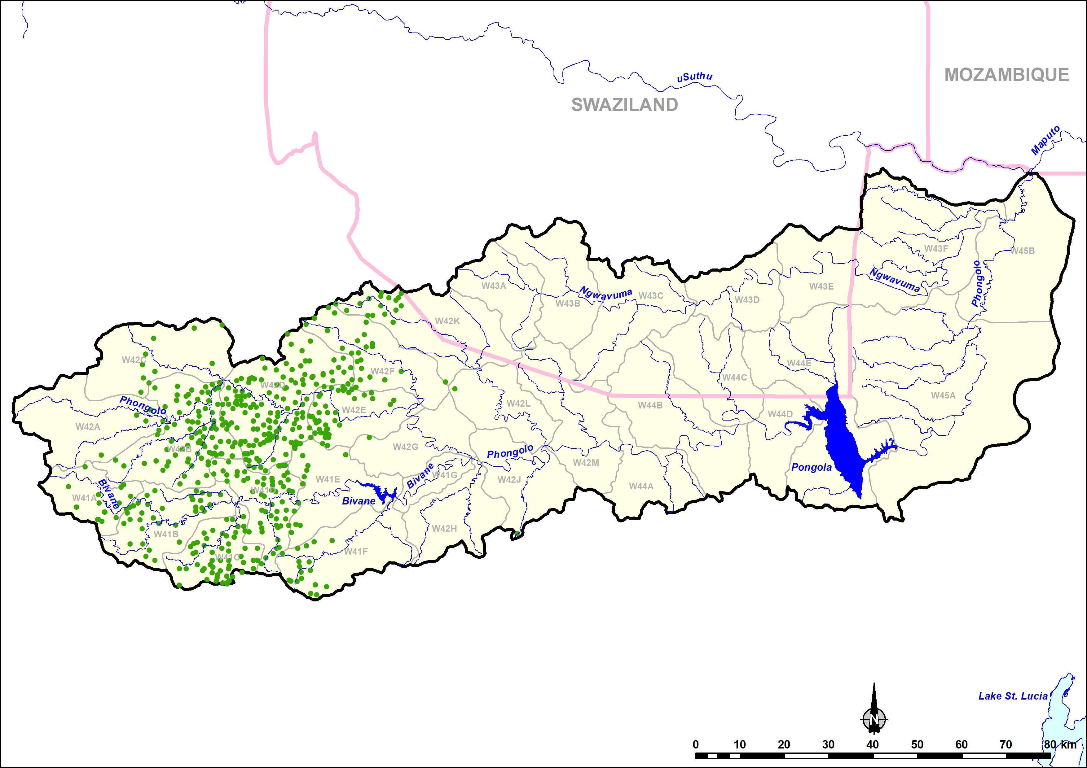
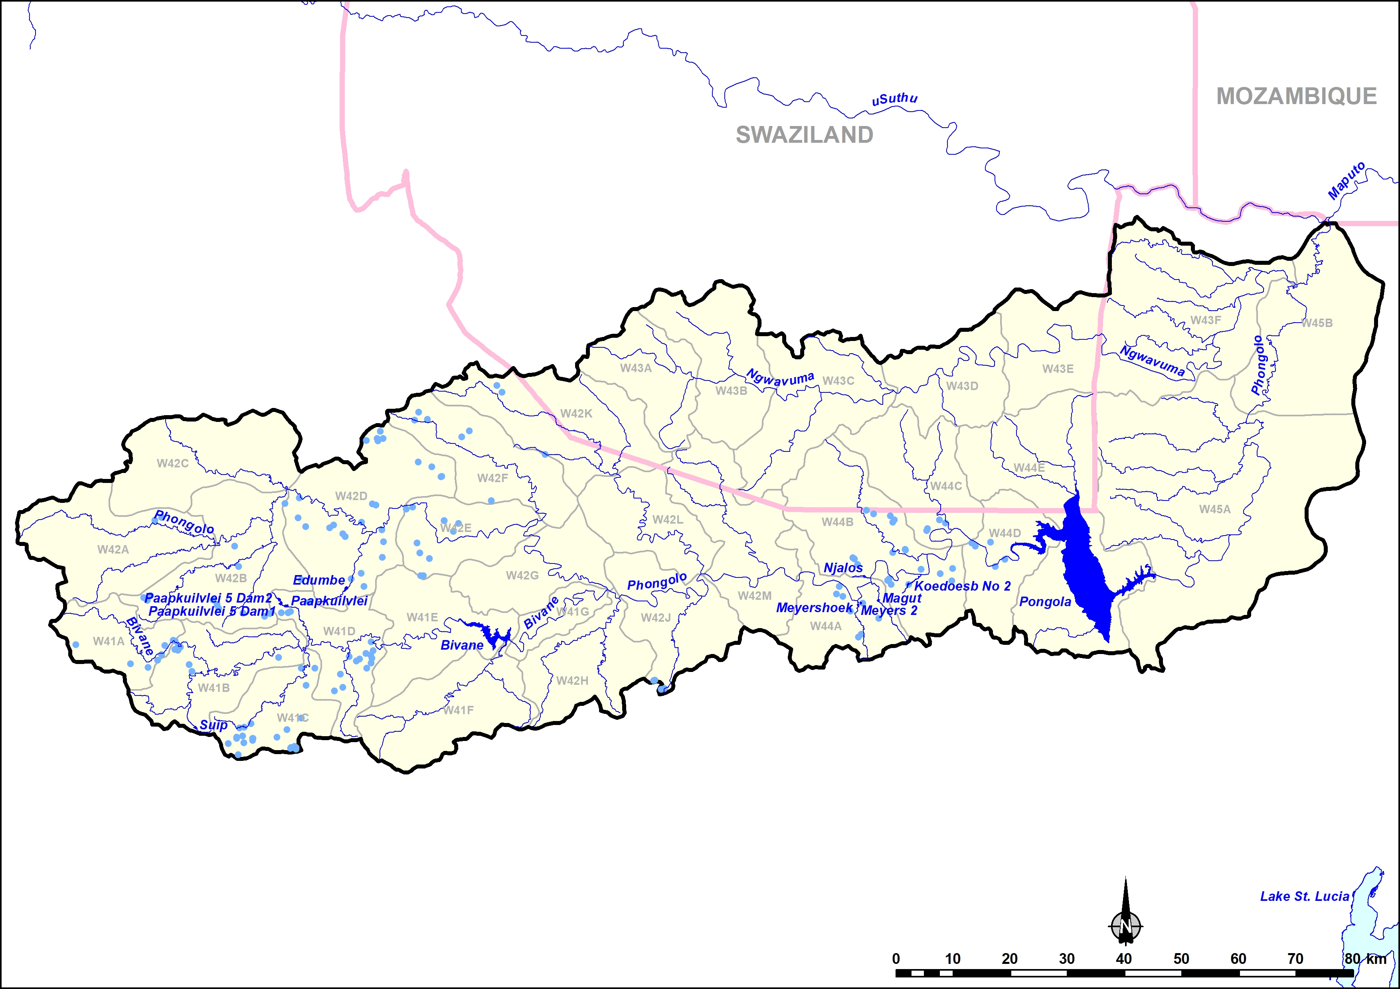
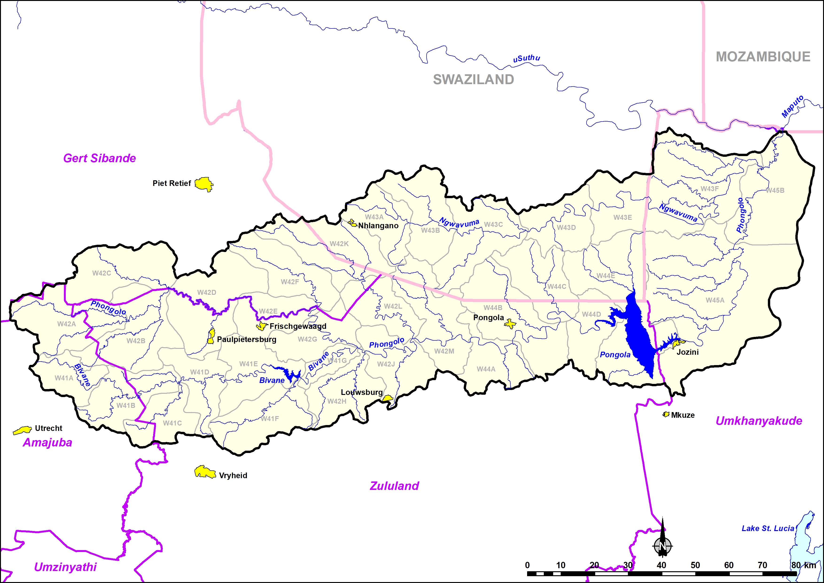
W4
Irrigation
Afforestation
Dams
Domestic

Slide 11
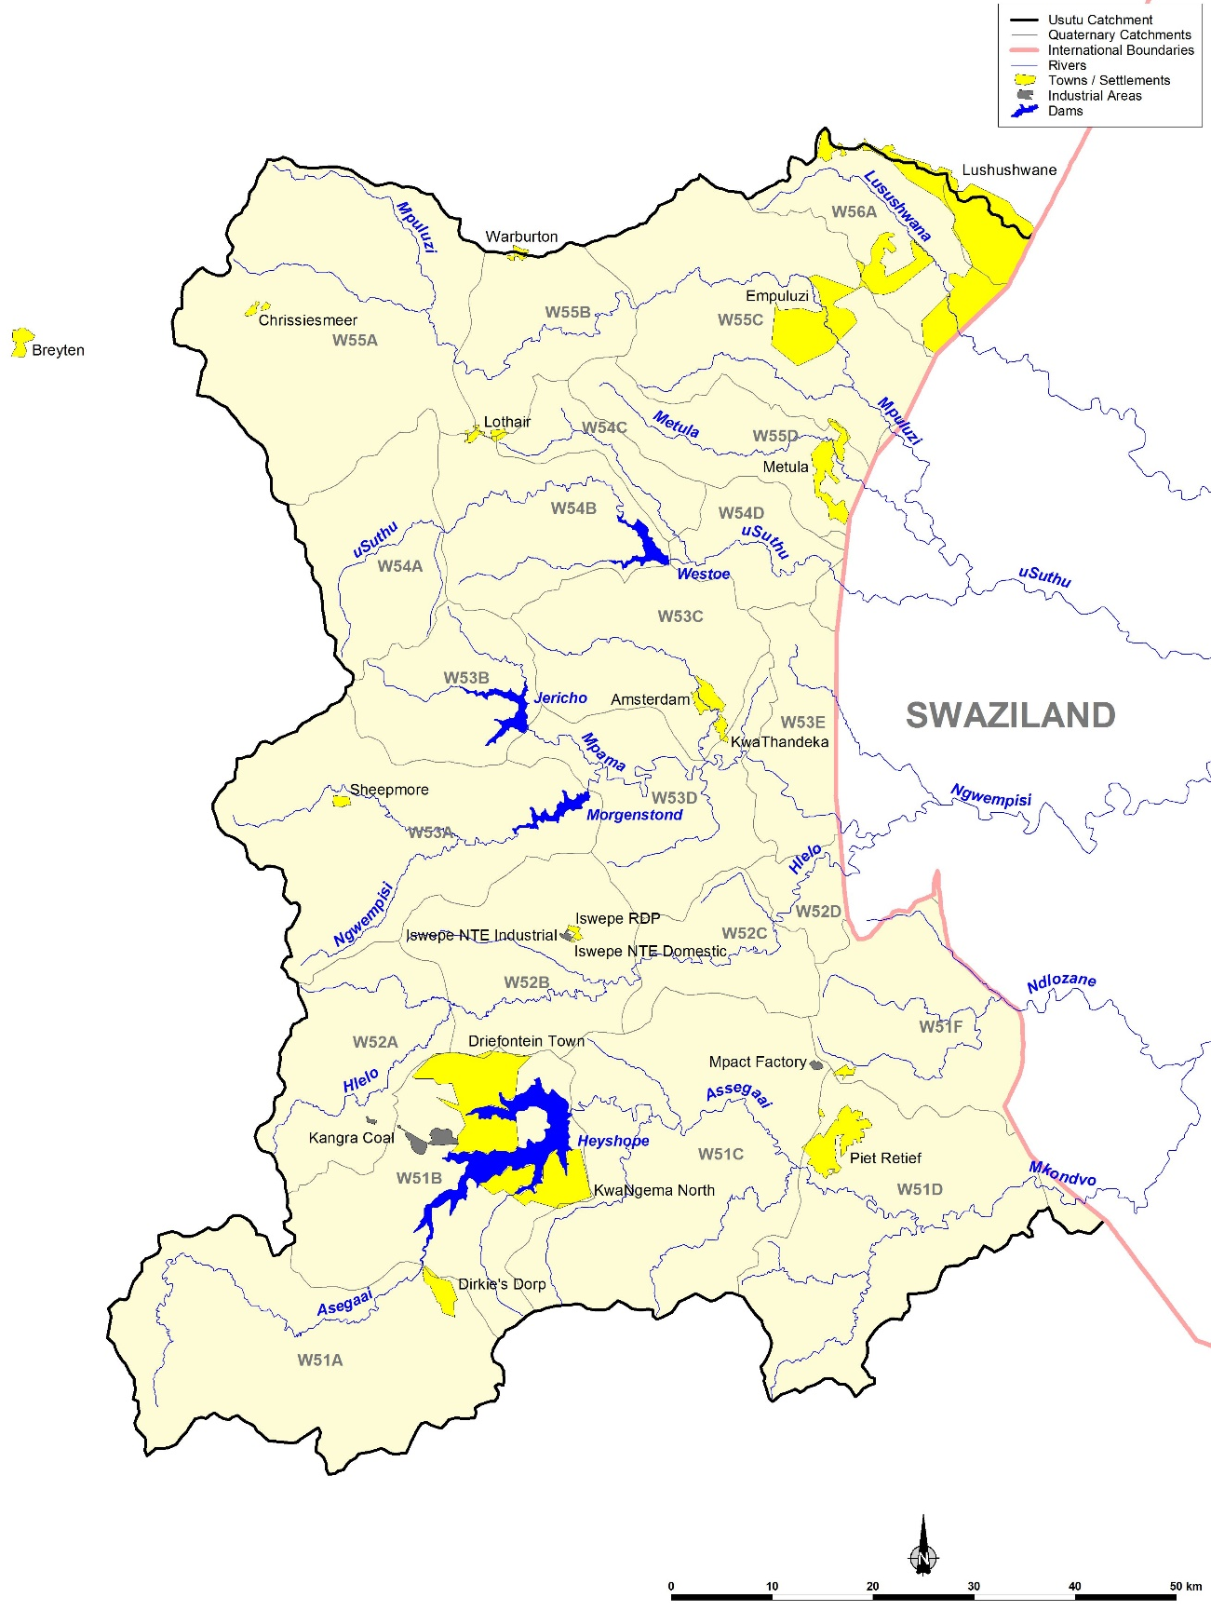
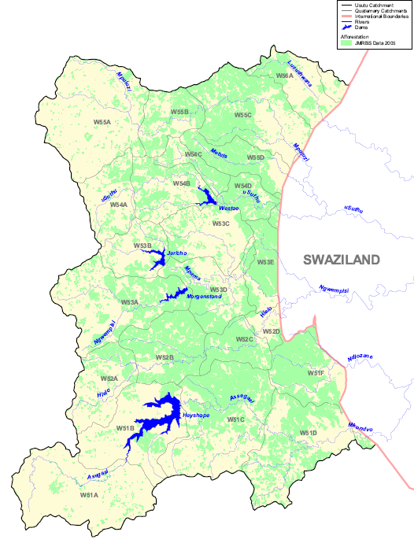
W5
Afforestation
Transfers out to Eskom

Slide 12
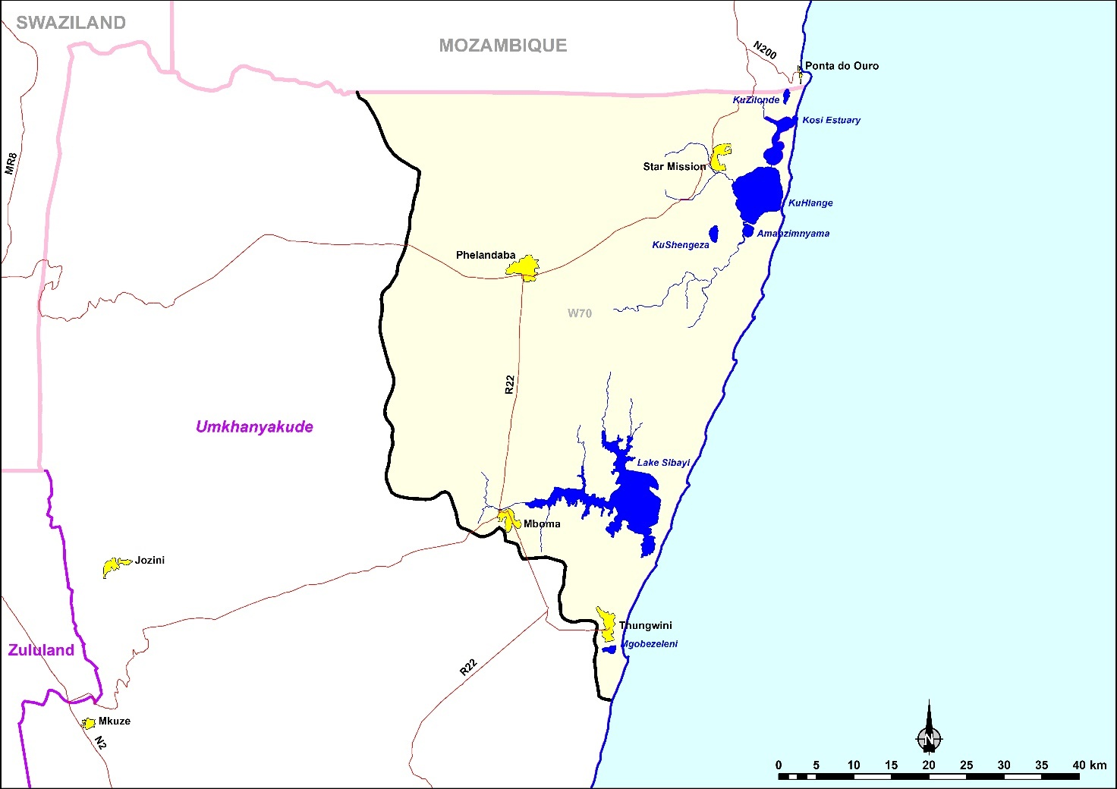
W7

